Slide 1
I/O Multplexing
School of Information and Communication Technology,
Hanoi University of Science and Technology

Slide 2
References
[1] W.Richard Stevens, Unix Network Programming Vol.1, 3rd Ed., Prentice Hall.
[2] Keir Davis, John W. Turner, and Nathan Yocom, The Definitive Guide to Linux Network Programming, Apress.
[3] Michael Donahoo, Kenneth Calvert, TCP/IP Sockets in C: Practical Guide for Programmers, Elsevier.

Slide 3
Content
I/O Models
Threads Synchronization
Multi-thread TCP Server

Slide 4
I/O Models
Blocking I/O
Non-blocking I/O
I/O multiplexing (select and poll)
Signal-driven I/O
Asynchronous I/O

Slide 5
I/O Models - Blocking
The most prevalent model for I/O
By default, all sockets are blocking
Application
Kernel
system call
recvfrom
no datagram ready
Wait for data
datagram ready -> copy
process blocks
Copy data from kernel to user
process datagram
return OK
copying completed

Slide 6
I/O Models - Nonblocking
When an I/O operation that I request cannot be completed without putting the process to sleep, do not put the process to sleep, but return an error instead
Application
Kernel
system call
Repeatedly call recvfrom (polling)
recvfrom
no datagram ready
EWOULDBLOCK
recvfrom
Wait for data
datagram ready -> copy
Copy data from kernel to user
process datagram
return OK
copying completed

Slide 7
I/O Models – Multiplexing
With I/O multiplexing, we call select or poll and block in one of these two system calls, instead of blocking in the actual I/O system call
Application
Kernel
system call
select
no datagram ready
Blocks in call to select
Wait for data
return readable
datagram ready -> copy
recvfrom
Blocks while copying
Copy data from kernel to user
process datagram
return OK
copying completed

Slide 8
I/O Models – Signal-driven
We can also use signals, telling the kernel to notify us with the SIGIO signal when the descriptor is ready
Application
Kernel
sigaction system call
Process continues normal execution
SIGIO signal handler
return
Wait for data
SIGIO event
datagram ready -> copy
signal handler
recvfrom
system call
Blocks while copying
Copy data from kernel to user
process datagram
return OK
copying completed

Slide 9
I/O Models – Asynchronous
In general, these functions work by telling the kernel to start the operation and to notify us when the entire operation (including the copy of the data from the kernel to our buffer) is complete
Application
Kernel
system call
aio_read
return
no datagram
Wait for data
Process continues normal execution
datagram ready -> copy
signal handler and process datagram
Copy data from kernel to user
deliver signal specified in aio_read
copying completed

Slide 10
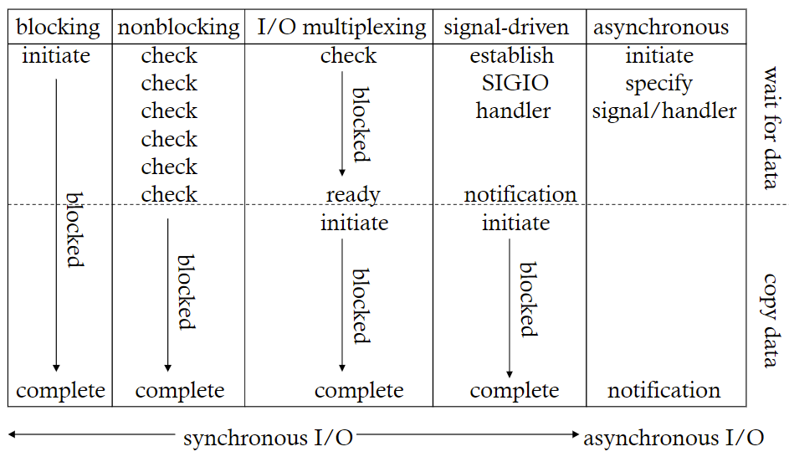
I/O Models
Comparison

Slide 11
select function
select() allows the process to instruct the kernel to wait for one or more events and to wake up the process only when events occur or when a specified time has passed
Example of select() return
  Any of descriptors in {1,4,5} are ready for reading
  Any of descriptors in {1,4,5} are ready for reading
  10.2 seconds have elapsed

Slide 12
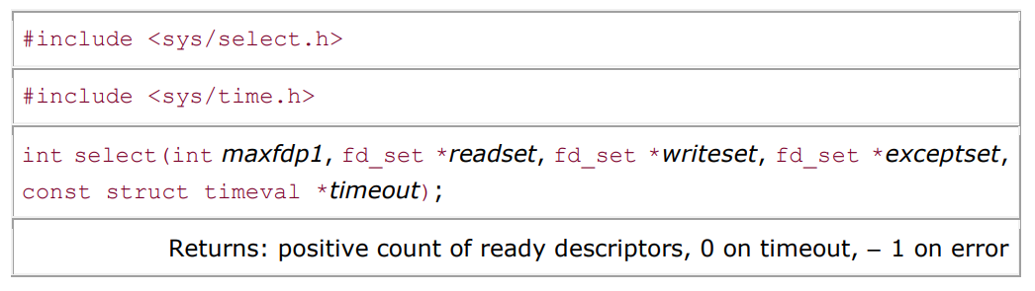
select() function
struct timeval {
long tv_sec; /* seconds */
long tv_usec; /* microseconds */
};

Slide 13
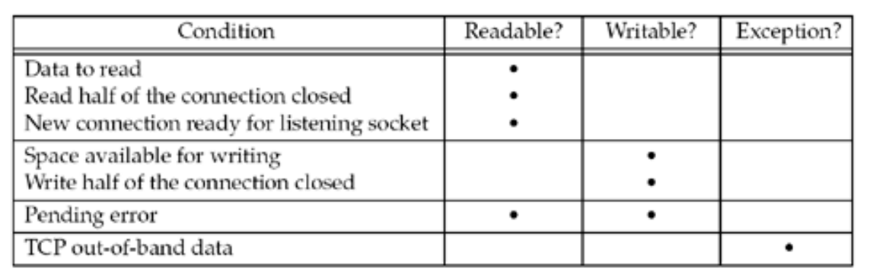
select() function
When a descriptor is ready?

Slide 14
select() function
Wait forever— Return only when one of the specified descriptors is ready for I/O. For this, we specify the timeout argument as a null pointer.
Wait up to a fixed amount of time— Return when one of the specified descriptors is ready for I/O, but do not wait beyond the number of seconds and microseconds specified in the timeval structure pointed to by the timeout argument.
Do not wait at all— Return immediately after checking the descriptors. This is called polling. To specify this, the timeout argument must point to a timeval structure and the timer value (the number of seconds and microseconds specified by the structure) must be 0.

Slide 15
Useful macros
void FD_ZERO(fd_set *fdset);
Clear all bits in fdset
void FD_SET(int fd, fd_set *fdset);
  Turn on the bit for fd in fdset
void FD_CLR(int fd, fd_set *fdset);
Turn off the bit for fd in fdset
int FD_ISSET(int fd, fd_set *fdset);
Is the bit for fd on in fdset ?

Slide 16
Example and excersizes
Write a “chat-room” server using select()

Slide 17
Number of Descriptors for select
<sys/types.h>
#ifndef FD_SETSIZE
#define FD_SETSIZE 256
#endif
The only way to increase the size of the descriptor sets is to increase the value of FD_SETSIZE and then recompile the kernel. Changing the value without recompiling the kernel is inadequate.

Slide 18
Thread and select combination
Use multi-thread approach to overcome the limit of FD_SETSIZE
Each thread handles a limited number (smaller than FD_SETSIZE) descriptors
By this approach:
  The number of threads dramatically decreases (compare to the pure multi-thread approach)
  Utilize select with a large number of descriptors

Slide 19
N số socket sẽ xử lý bằng select trong 1 luồng
MAIN
THREAD 1 (N)
THREAD 2 (2N)
SELECT
SOCKET
ACCEPT
SELECT
SELECT
Client 0
Client N
Client 2N
Client 1
Client N+1
Client 2N+1
Client N-1
Client 2N-1

Slide 20
Q&A

